Slide 1

Tata group

Slide 2
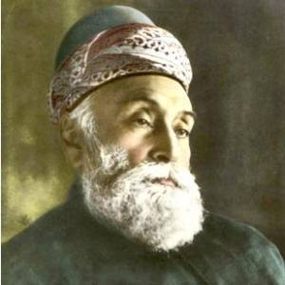
History of Tata Group
The story of Tata begins during the reign Of the British Empire
India back then was a huge exporter of cotton But the brutal regime of the British East
India Company left little room for local entrepreneurs To develop
In 1857 Which ended the power of the British East India Company and replaced it with the British Raj.
India was an exporting country, the First Indian entrepreneurs came from That sector and one of them was Jamsetji Tata
Jamsetji Tata

Slide 3
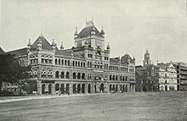
First generation of Tata Group
He graduated in 1858, exactly the perfect Time to take advantage of the economic reforms Of the British Raj.
in 1859 Jamsetji went to Hong Kong To develop a subsidiary
The sheer scale of British commerce there He realized that the Tata export business Had truly global potential.
He’d eventually create his own exporting Company in 1868 and He started building textile mills of his own
Jamsetji’s philosophy Was find the best practices used across the World and to bring them back to India
This Ph

Slide 4
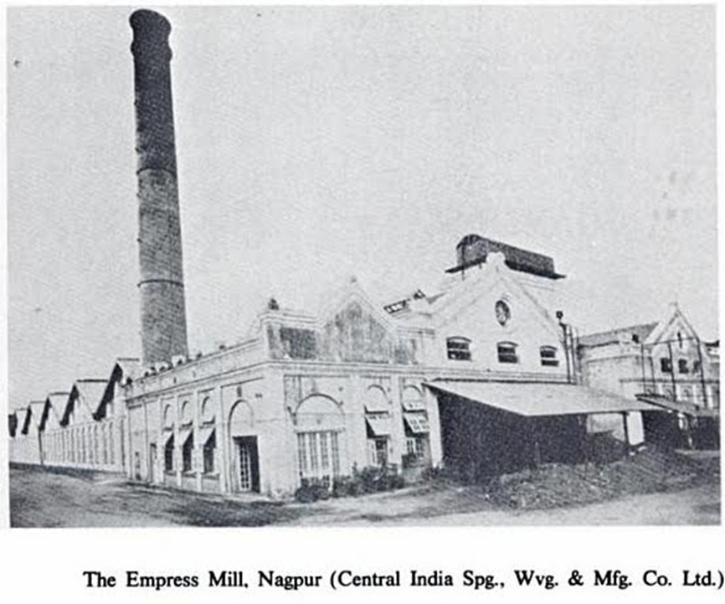
First generation of Tata Group
In his textile mills he enacted policies that Were virtually unknown to most of India, like Offering sickness benefits and pensions to His employees.
he saw the wonders the Industrial Revolution had created in Europe and he wanted to recreate them back home
He began working on a steel production plant in 1901, modeled after the ones he had seen in Germany
hydroelectric project, inspired by his visit to the Niagara Falls power plant in 1903.

Slide 5
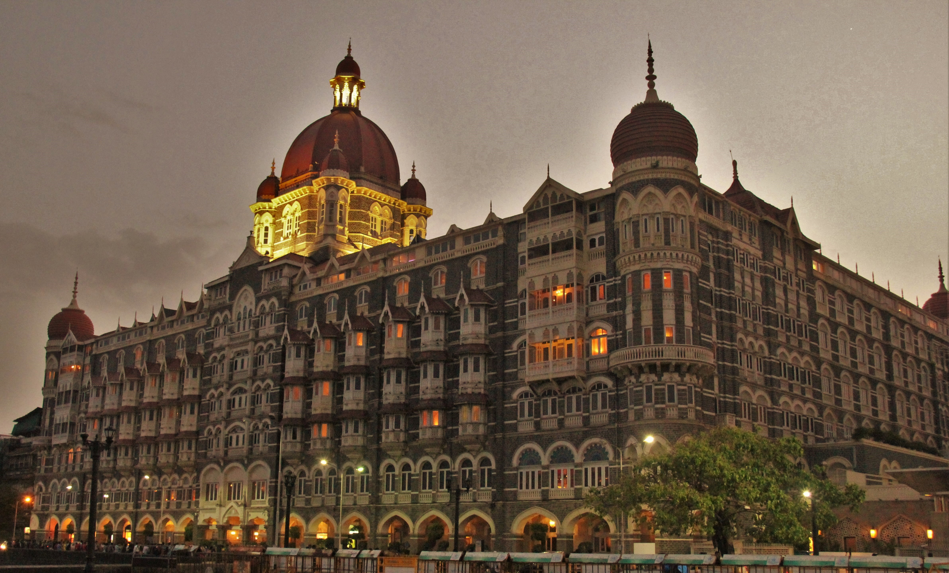
First generation of Tata Group
Jamsetji realized the incredible power of tourism and so he also created a chain of hotels, starting with the Taj Mahal Palace Hotel
he valued education to the point where he donated land and buildings towards the creation of the Indian Institute of Science
However He would not live to see most of his projects because he died while on a business trip in Germany in 1904, leaving the already sizable Tata company to his two sons.

Slide 6
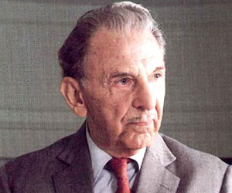
Second generation of Tata Group
Jamsetji’s sons fulfilled many of their father’s ambitions
they oversaw the creation of India’s first steel works in 1907
India’s first cement plant in 1912
first indigenous insurance company in 1919.
By the time the leadership mantle passed onto the next generation in 1938, Tata Sons was comprised of 14 different companies.
Jehangir Tata (jrd)

Slide 7
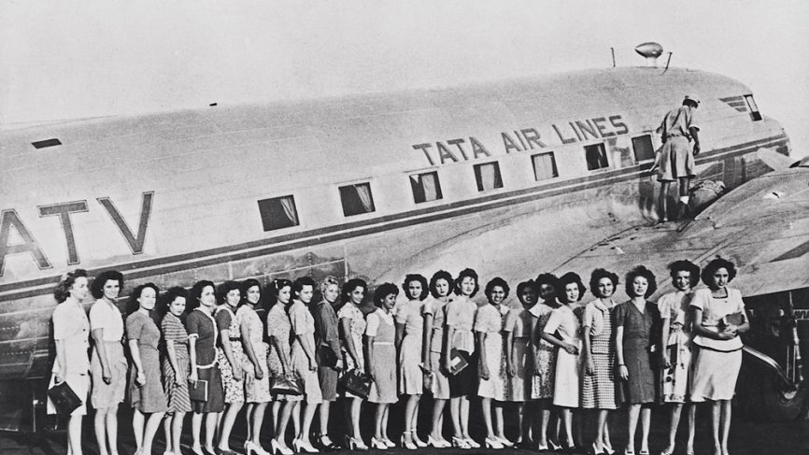
Second generation of Tata Group
This time instead of handing over leadership to one of Jamsetji’s grandsons, instead it went into the hands of a distant cousin
Jehangir Tata, better known as JRD, he had been in the company since 1925, but he had been raised in France
JRD was a passionate aviator and in 1929 he obtained India’s first pilot license
his first big project at Tata was to develop an airline
In 1932 he created the Tata Air Service, which originally only carried mail, but then in 1938 started passenger flights as well, even helping out the British in the Second World War.

Slide 8
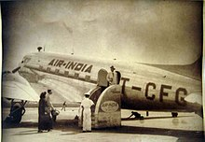
Second generation of Tata Group
India’s first prime minister saw just how successful JRD had been with his airline and in 1953 he decided to nationalize it with the name of air india by buying 49% of the company stack
He kept JRD as the airline’s chairman until 1977
He created Tata Motors in 1945, originally with the idea of building locomotives, but in 1954 he branched out into commercial vehicles through a partnership with the German car company
Over the course of his 52 years of leadership, JRD expanded the Tata Group from 14 companies to 95 companies

Slide 9
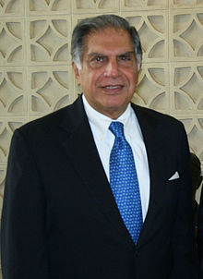
Third generation of Tata Group
As JRD expanded the group and lowered its ownership in the individual subsidiaries, he started losing control.
Ratan Tata. One of Jamsetji’s great-grandchildren and he joined the Tata Group in 1962. His first major project came in 1971
Ratan was given charge of a struggling Tata company known as NELCO, which in the 1950s was India’s biggest producer of radios, but just twenty years later it had fallen to a 3% market share.
instead of trying to rescue the radio, he instead funded the development of new products like satellite communications, which restored NELCO in the 1980s

Slide 10
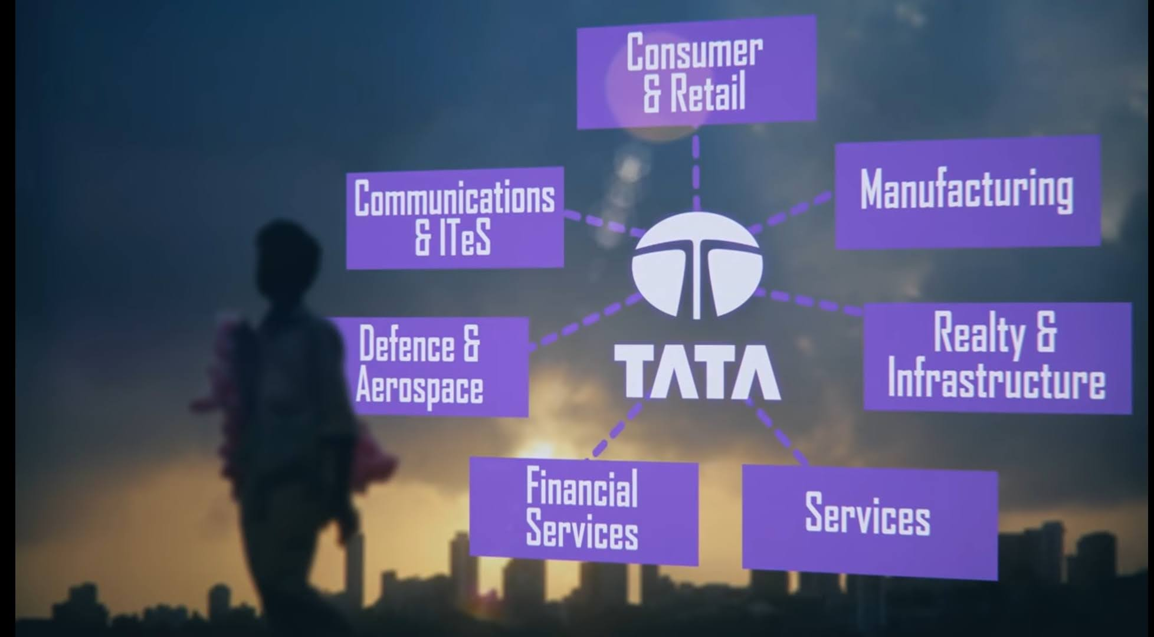
Third generation of Tata Group
Ratan claimed leadership of the Tata Group in 1991
As a wave of economic liberalization swept across India Finally joined the global capital market, but this presented a big threat to Tata.
JRD had let Tata become extremely decentralized, so it would be very slow to adapt to new competitor
Ratan had no choice but to re-establish ownership over all the Tata subsidiaries
So He sold 20% of Tata Sons, the holding company, and used that money to buy shares in the Tata subsidiaries, especially Tata Steel and Tata Motors

Slide 11
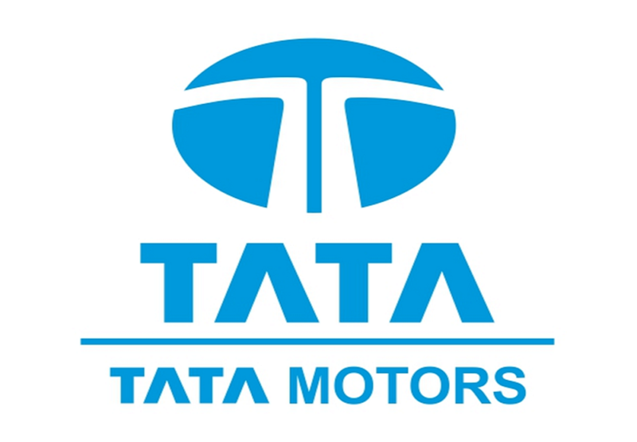
Third generation of Tata Group
He then reorganized all hundred subsidiaries into seven sectors, establishing a framework along which he could actually control them.
in 1990s pretty much every Tata company was losing ground to international competitors.
he slowly started acquiring foreign competitors and absorbing them into the Tata Group
At the end of year 1998 tata motors launched tata indica which was the first modern car ever to be designed by an indian company
The car sale rate was so poor that tata group decided to sale their car business

Slide 12
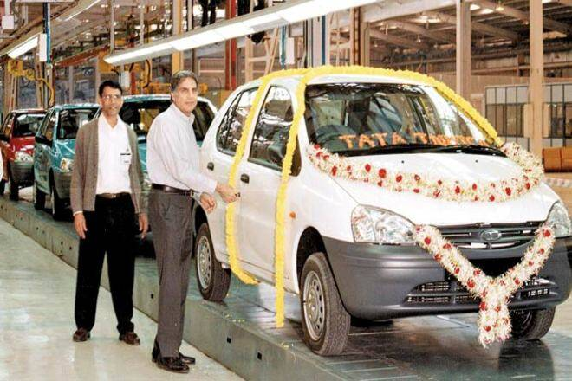
Third generation of Tata Group
In 1999 ford was interested in buying tata’s motor business
They invited tata group for a meeting in their head office in detroit
Ratan tata along with his team flew all the way to DetroitBut in broad meeting ratan tata was humiliated in front of his team by ford chair man bill ford
Bill ford told ratan tata “ you do not known anything why did you start the passager car division at all We are doing you a big favour by buying your car division ”
Ratan tata just couldn’t stay still after being humiliated like that same night he decided not to sale his car division and he flew back to india along with his team

Slide 13
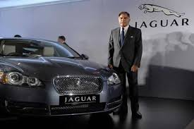
Third generation of Tata Group
He turned all his focus on tata motors
With time tata motors became a successful car company all over the world
By 2008 tata motors had best selling cars in market
In 2008 ratan offered to buy jaquar and land rover which were ford’s worst selling cars back then
This time bill ford along with his team came to india
And in meeting he told ratan that “ he is doing big favour by buying jlr”
He would have humiliated ford has he was humiliated back in 1999 but he came out to be bigger and better person

Slide 14
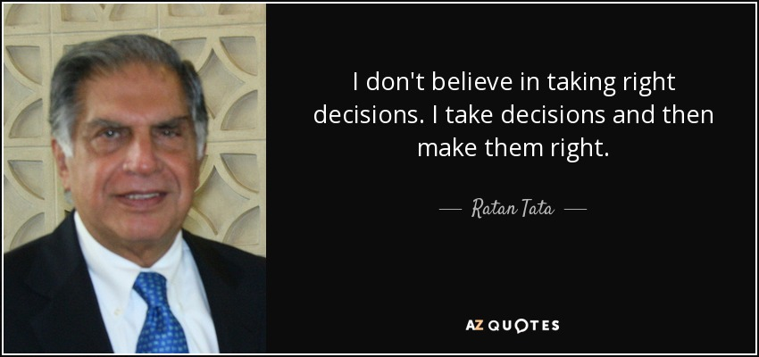
Third generation of Tata Group
he said in his quote “I don’t believe in taking right decision I take decision and then make them right’’
Today jaquar and land rover are most successful selling car of tata motors
Tata motors is one of the biggest car companies in the world
Ratan tata is one of the most praised businessman around the world not only for the huge empire which he had built but also for his kind and humble nature
Tata group denates 66% of their profit to charities
Ratan tata’s story with ford teach us one thing

Slide 15
“SUCCESS IS THE BEST WAY OF REVENGE”

